Slide 1
CS5100 Advanced Computer Architecture Hardware-Based Speculation
Prof. Chung-Ta King
Department of Computer Science
National Tsing Hua University, Taiwan
(Slides are from textbook, Prof. Hsien-Hsin Lee, Prof. Yasun Hsu)

Slide 2
About This Lecture
Goal:
To understand the issues remained unsolved by Tomasulo Algorithm
To understand the concepts and techniques of hardware-based speculation
Outline:
Hardware-based speculation (Sec. 3.6)
1

Slide 3
OOO Commit in Tomasulo Algorithm
In-order issue, but OOO execution, completion, commitment

Slide 4
What’s Wrong with OOO Commitment?
OOO commit across branch → speculative execution
Problem: program state is updated speculatively even before the dependent control statement is known to take
What if BNEZ after 1st SD is evaluated to not-taken at cycle 17?
→ but 2nd MULTD has updated program state (F4) at cycle 16!

Slide 5
What’s Wrong with OOO Commitment?
OOO commit under interrupt and resume
Suppose 1st SD causes a page fault at cycle 17
An interrupt is raised and hardware saves its PC
When return from interrupt, execution starts from SD (PC points to it) and all following instructions (LD, MULTD, SD)
LD and MULTD will be executed again and MULTD will use wrong value in F4 → imprecise interrupt
F4
F4

Slide 6
Desired Features
Want speculative OOO execution beyond branches, but without any consequence
Speculation: execute an instruction before knowing it should be executed, e.g., beyond a branch
Without consequences: speculative instructions (if wrongly speculated) must not alter the program states
Want OOO execution with precise interrupt
All instructions before the interrupted instruction must be completed and committed
The program state should appear as if no instruction issued after the interrupted instruction
Maintain “program state” as in sequential execution → restart from saved PC with saved program state

Slide 7
Hardware-Based Speculation
Basic idea:
Execute instructions along predicted execution paths but only commit the results if prediction is correct
Allow OOO execution but commit in-order
Combine three ideas:
Dynamic OOO instruction scheduling (Tomasulo Algo.)
Dynamic branch prediction
Speculative execution: execute instructions before all control dependencies are resolved
Extra hardware requirement:
Temporary storage to buffer speculative execution result until commit → reorder buffer (ROB)

Slide 8
Tomasulo Algorithm with Speculation
Key idea: add a commit phase
Issue
Execute
Write result: write results to CDB and store results in a hardware buffer (reorder buffer)
Commit: update register file or memory if no longer speculative

Slide 9
Reorder Buffer (ROB)
HW buffer for results of uncommitted instructions
At least 3 fields: instruction, destination, value
Can be operand source → virtual registers
Use reorder buffer # instead of reservation station # as tag ID on CDB
Supplies operands between execution complete and commit
After instruction commits, result is put into register
Easy to undo speculated instr. on mispredicted branches or exceptions
Reorder
Buffer
FP
Op
Queue
FP Regs
Res Stations
Res Stations
FP Adder
FP Adder

Slide 10
Speculative Tomasulo Algorithm
Issue (IS): get instruction from FP op queue
If RS and ROB slot free, issue instruction and send operands and ROB no. for destination
Operands may come from register file or ROB (if not committed yet)
Execution (EX): operate on operands
When either operands not ready, watch CDB for result (check RAW)
When both operands in RS, execute

Slide 11
Speculative Tomasulo Algorithm
Write result (WB): execution complete
Write on CDB to all awaiting RSs and ROB
Commit: update registers from reorder buffer
When instruction at head of ROB and result present, update register with result (or store to memory) → change program state
Remove instruction from ROB
Mispredicted branch flushes ROB

Slide 12
Commit Step
New step for making instruction execution “visible” to the outside world, e.g., assembly program
It “commits” the changes to the program state
ROB
ROB head
commit
Outside World “sees”:
A
✓
ARF
B
✓
A executed
C
✓
B executed
D
✓
C executed
E
✓
Architecture register file
D executed
F
✓
E executed
G
✓
H
✓
Instructions executed out of program order,
but outside world still “believes” it is in-order
J
✓
tail
K
✓
Notes:
From GIT’s Loh.

Slide 13
Handling Incorrect Speculation
Instructions following mispredicted branch, i.e. those in decode/issue buffers & RSs, are flushed
ROB entries of these instructions are deallocated
Restart fetch at correct branch successor
Inject correct PC
Branch
Prediction
Branch
Resolution
Kill
update
Kill
Kill
PC
Fetch
Decode
Reorder Buffer
Commit
Complete
Execute

Slide 14
Handling Precise Exception/Interrupt
Must ensure exceptions/interrupts in program order for precise interrupt
Idea: take care of exceptions at commit time
If an instruction raises exception, wait until it reaches head of ROB and then takes interrupt, flushes any other pending instructions
Instructions behind it are re-executed
Because instructions commit in order, this yields a precise exception

Slide 15
Handling Precise Exception/Interrupt
Instructions fetched and decoded into ROB in-order
Execution is out-of-order → OOO completion
Commit (write-back to program state, i.e., register file and memory) is in-order
In-order
Out-of-order
In-order
Fetch
Decode
Reorder Buffer
Commit
Kill
Kill
Kill
Exception?
Execute
Inject handler PC

Slide 16
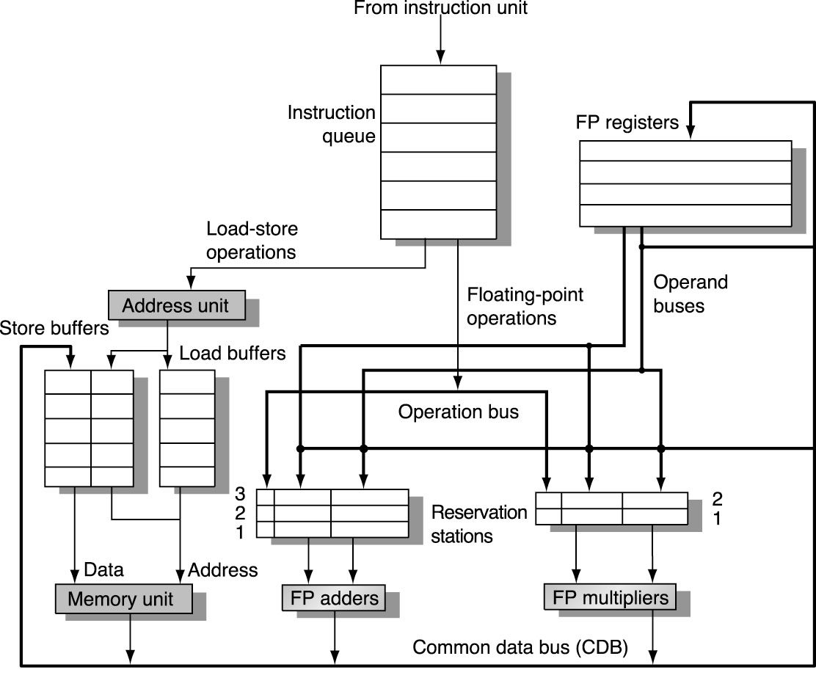
Tomasulo without Speculation
Data addr
Addr

Slide 17
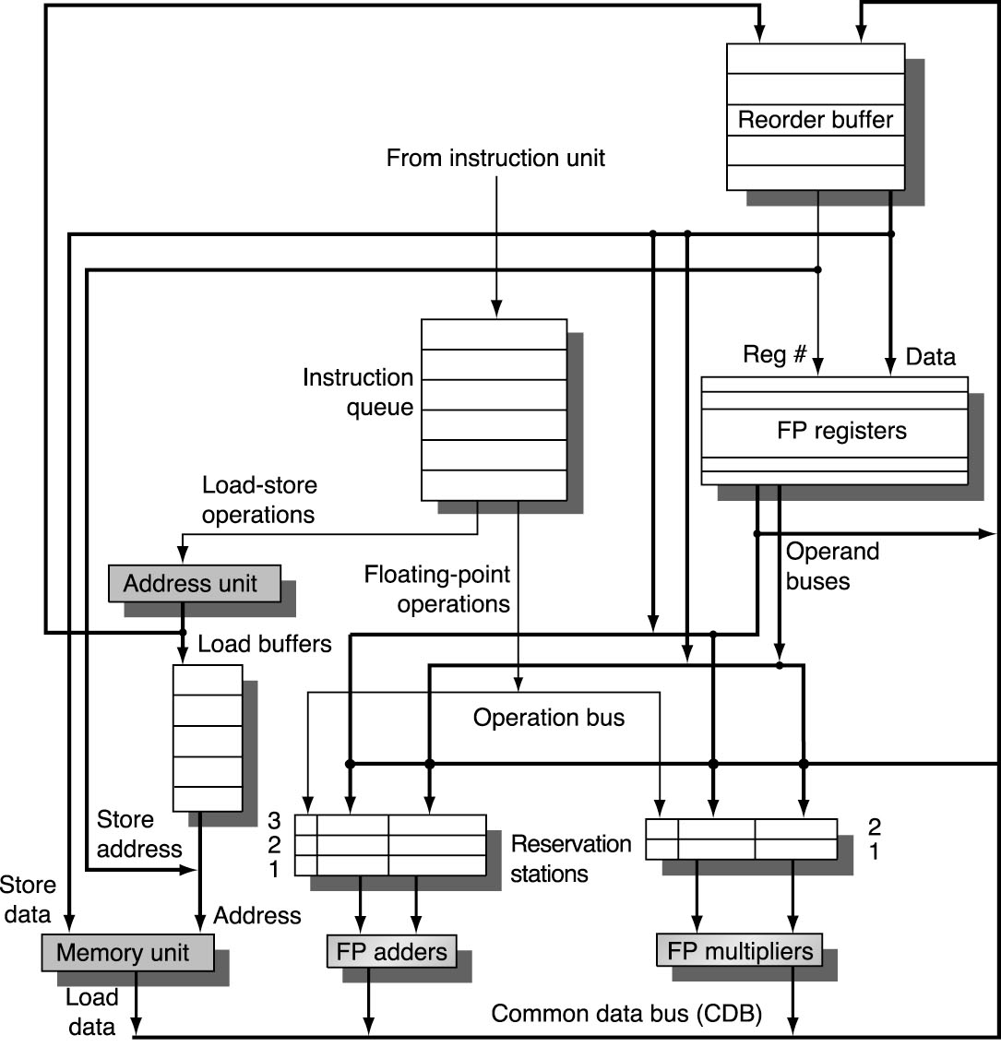
Tomasulo with Speculation via ROB
Load addr

Slide 18
Speculative Tomasulo with ROB
dest
value instn
Done?
FP Op
Queue
ROB7
ROB6
ROB5
ROB4
ROB3
ROB2
ROB1
Newest
Reorder Buffer
Oldest
F0
LD F0,10(R2)
N
Registers
For store
To Memory
From Memory
Dest
For load
Stall
Dest
Dest
ROB1 10+R2
FP adders
FP multipliers
Notes:
LD encounters a cache miss

Slide 19
Speculative Tomasulo with ROB
dest
value instn
Done?
FP Op
Queue
ROB7
ROB6
ROB5
ROB4
ROB3
ROB2
ROB1
Newest
Reorder Buffer
F10
ADDD F10,F4,F0
N
Oldest
F0
LD F0,10(R2)
N
Registers
For store
To Memory
ROB2 ADDD R(F4),LD1
From Memory
Dest
For load
Dest
Dest
ROB1 10+R2
FP adders
FP multipliers

Slide 20
Speculative Tomasulo with ROB
dest
value instn
Done?
FP Op
Queue
ROB7
ROB6
ROB5
ROB4
ROB3
ROB2
ROB1
Newest
Reorder Buffer
F2
DIVD F2,F10,F6
N
F10
ADDD F10,F4,F0
N
Oldest
F0
LD F0,10(R2)
N
Registers
For store
To Memory
ROB2 ADDD R(F4),LD1
From Memory
ROB3 DIVD ADD1,R(F6)
Dest
For load
Dest
Dest
ROB1 10+R2
FP adders
FP multipliers

Slide 21
Speculative Tomasulo with ROB
dest
value instn
Done?
FP Op
Queue
ROB7
ROB6
ROB5
ROB4
ROB3
ROB2
ROB1
Newest
F0
ADDD F0,F4,F6
N
F4
LD F4,0(R3)
N
Reorder Buffer
--
BNE F0,<…>
N
F2
DIVD F2,F10,F6
N
F10
ADDD F10,F4,F0
N
Oldest
F0
LD F0,10(R2)
N
Registers
For store
To Memory
ROB2 ADDD R(F4),LD1
From Memory
ROB6 ADDD LD2, R(F6)
ROB3 DIVD ADD1,R(F6)
Dest
For load
Dest
Dest
ROB1 10+R2
ROB5 0+R3
FP adders
FP multipliers
Notes:
WAW hazard on F0

Slide 22
Speculative Tomasulo with ROB
dest
value instn
Done?
FP Op
Queue
--
ST 0(R3),F4
N
ROB7
ROB6
ROB5
ROB4
ROB3
ROB2
ROB1
Newest
F0
ADDD F0,F4,F6
N
F4
LD F4,0(R3)
N
Reorder Buffer
--
BNE F0,<…>
N
F2
DIVD F2,F10,F6
N
F10
ADDD F10,F4,F0
N
Oldest
F0
LD F0,10(R2)
N
Registers
For store
To Memory
ROB2 ADDD R(F4),LD1
From Memory
ROB6 ADDD LD2, R(F6)
ROB3 DIVD ADD1,R(F6)
Dest
For load
Dest
Dest
ROB1 10+R2
ROB5 0+R3
FP adders
FP multipliers

Slide 23
Speculative Tomasulo with ROB
dest
value instn
Done?
FP Op
Queue
--
ST 0(R3),F4
N
ROB7
ROB6
ROB5
ROB4
ROB3
ROB2
ROB1
Newest
F0
ADDD F0,F4,F6
N
F4
M[10]
LD F4,0(R3)
Y
Reorder Buffer
--
BNE F0,<…>
N
F2
DIVD F2,F10,F6
N
F10
ADDD F10,F4,F0
N
Oldest
F0
LD F0,10(R2)
N
Registers
For store
To Memory
ROB2 ADDD R(F4),LD1
From Memory
ROB6 ADDD M[10],R(F6)
ROB3 DIVD ADD1,R(F6)
Dest
For load
Dest
Dest
ROB1 10+R2
FP adders
FP multipliers
Notes:
2nd LD completed
RS2 of adder is ready

Slide 24
Speculative Tomasulo with ROB
dest
value instn
Done?
FP Op
Queue
--
ST 0(R3),F4
N
ROB7
ROB6
ROB5
ROB4
ROB3
ROB2
ROB1
Newest
F0
ADDD F0,F4,F6
Ex
F4
M[10]
LD F4,0(R3)
Y
Reorder Buffer
--
BNE F0,<…>
N
F2
DIVD F2,F10,F6
N
F10
ADDD F10,F4,F0
N
Oldest
F0
M[50]
LD F0,10(R2)
Y
Registers
For store
To Memory
ROB2 ADDD R(F4),M[50]
From Memory
ROB3 DIVD ADD1,R(F6)
Dest
For load
Dest
Dest
FP adders
FP multipliers
Notes:
2nd ADDD fired into FP adder
RS1 for 1st ADDD is ready
1st LD completed

Slide 25
Speculative Tomasulo with ROB
dest
value instn
Done?
FP Op
Queue
--
ST 0(R3),F4
N
ROB7
ROB6
ROB5
ROB4
ROB3
ROB2
ROB1
Newest
F0
<val2>
ADDD F0,F4,F6
Y
F4
M[10]
LD F4,0(R3)
Y
Reorder Buffer
--
BNE F0,<…>
N
F2
DIVD F2,F10,F6
N
F10
ADDD F10,F4,F0
Ex
Oldest
Program state changed
Registers
For store
F0
M[50]
To Memory
From Memory
ROB3 DIVD ADD1,R(F6)
Dest
For load
Dest
Dest
FP adders
FP multipliers
Notes:
1st LD commit to register F0
2nd ADDD completed
1st ADDD fired

Slide 26
Speculative Tomasulo with ROB
dest
value instn
Done?
FP Op
Queue
--
ST 0(R3),F4
N
ROB7
ROB6
ROB5
ROB4
ROB3
ROB2
ROB1
Newest
F0
<val2>
ADDD F0,F4,F6
Y
F4
M[10]
LD F4,0(R3)
Y
BNE mispredicted
Reorder Buffer
--
BNE F0,<…>
N
F2
DIVD F2,F10,F6
N
F10
<val1>
ADDD F10,F4,F0
Y
Oldest
Registers
For store
F0
M[50]
To Memory
From Memory
ROB3 DIVD <val1>,R(F6)
Dest
For load
Dest
Dest
FP adders
FP multipliers
Notes:
1st ADDD completed
BNE found to be mispredicted

Slide 27
Speculative Tomasulo with ROB
dest
value instn
Done?
FP Op
Queue
ROB7
ROB6
ROB5
ROB4
ROB3
ROB2
ROB1
Newest
Reorder Buffer
--
BNE F0,<…>
Y
F2
DIVD F2,F10,F6
N
F10
<val1>
ADDD F10,F4,F0
Y
Oldest
All speculative instructions are flushed!
Registers
For store
F0
M[50]
To Memory
From Memory
ROB3 DIVD <val1>,R(F6)
Dest
For load
Dest
Dest
FP adders
FP multipliers

Slide 28
Speculative Tomasulo with ROB
dest
value instn
Done?
FP Op
Queue
ROB7
ROB6
ROB5
ROB4
ROB3
ROB2
ROB1
Newest
F5
ADDD F5,F6,F2
N
Reorder Buffer
--
BNE F0,<…>
Y
F2
DIVD F2,F10,F6
Ex
New instructions fetched from correct path
Oldest
F[10] ← <val1>
Registers
For store
F0
M[50]
To Memory
ROB5 ADDD R(F6),MULT1
From Memory
Dest
For load
Dest
Dest
FP adders
FP multipliers
Notes:
1st ADDD committed and register F10 is updated
1st DIVD fired
New instructions fetched from correct path

Slide 29
ROB Handling Precise Interrupts
Spec?
Exp
event
Done?
PC
V
RegDst
Data (physical register)
Head
0
xA000
11
R1=R1+10
1
0
0
1
0000
R1
1
0
0
xA004
0000
R2
R2=R2*2
Tail
1
0
0
xA008
0000
FR1
FR1=FR2/0.0
.
.
.
.
.
.
ARF
R1
1
R2
11
2
1
R3
3
1
R4
4
1
1
R31

Slide 30
ROB Handling Precise Interrupts
Spec?
Exp
event
Done?
PC
V
RegDst
Data (physical register)
0
Head
1
0
0
xA004
0000
R2
R2=R2*2
1
0
0
xA008
0000
FR1
FR1=FR2/0.0
1
0
0
xA00C
0000
R3
R3=R3+1
Tail
.
.
.
.
.
.
ARF
R1
1
11
R2
2
1
R3
3
1
R4
4
1
1
R31

Slide 31
ROB Handling Precise Interrupts
Spec?
Exp
event
Done?
PC
V
RegDst
Data (physical register)
0
Head
1
0
0
xA004
0000
R2
R2=R2*2
1
0
0
xA008
0000
FR1
FR1=FR2/0.0
1
0
1
xA00C
0000
R3
4
R3=R3+1
1
0
0
xA010
0000
R4
R4=R4*2
Tail
.
.
.
.
.
.
ARF
R1
1
11
R2
2
1
R3
3
1
R4
4
1
1
R31

Slide 32
ROB Handling Precise Interrupts
Spec?
Exp
event
Done?
PC
V
RegDst
Data (physical register)
0
Head
1
0
0
xA004
0000
R2
R2=R2*2
1
4
1
0
0
xA008
0000
FR1
FR1=FR2/0.0
1
0
1
xA00C
0000
R3
4
R3=R3+1
1
0
1
xA010
0000
R4
8
R4=R4*2
1
0
0
xA014
0000
FR4
LD FR4,M[50]
0101
Tail
.
.
.
.
.
.
ARF
R1
1
Exception raised
11
R2
4
2
1
R3
3
1
R4
4
1
1
R31

Slide 33
ROB Handling Precise Interrupts
Spec?
Exp
event
Done?
PC
V
RegDst
Data (physical register)
0
Head
1
0
1
xA004
0000
R2
R2=R2*2
0
4
1
0
0
xA008
0000
FR1
FR1=FR2/0.0
0010
1
0
1
xA00C
0000
R3
4
R3=R3+1
1
0
1
xA010
0000
R4
8
R4=R4*2
1
0
0
xA014
0101
FR4
LD FR4,M[50]
Tail
.
.
.
.
.
.
ARF
R1
1
Exception raised
11
R2
4
1
R3
3
1
R4
4
1
1
R31

Slide 34

ROB Handling Precise Interrupts
Spec?
Exp
event
These values were not committed into RF but flushed
Done?
PC
V
RegDst
Data (physical register)
0
0
Head
1
0
0
xA008
0010
FR1
FR1=FR2/0.0
1
0
1
xA00C
0000
R3
4
R3=R3+1
1
0
1
xA010
0000
R4
8
R4=R4*2
1
0
0
xA014
0101
FR4
LD FR4,M[50]
Tail
.
.
.
.
.
.
ARF
R1
1
Push “PC” and current RF into stack
Exception detected
11
R2
4
1
R3
3
1
R4
4
1
1
Depending on the exception, process will either abort or instructions will be resumed from this faulting instruction
R31

Slide 35
ROB Handling Precise Interrupts
Spec?
Exp
event
Done?
PC
V
RegDst
Data (physical register)
0
0
Head
1
0
0
xA008
0000
FR1
FR1=FR2/0.0
1
0
0
xA00C
0000
R3
R3=R3+1
1
0
0
xA010
0000
R4
R4=R4*2
1
0
0
xA014
0000
FR4
LD FR4,M[50]
Tail
.
.
.
.
.
.
ARF
After exception, “PC” and RF are popped back and all following instructions are executed again
R1
1
11
R2
4
1
R3
3
1
R4
4
1
1
R31

Slide 36
Recap
Problems with dynamic scheduling
OOO commit on speculative execution
OOO commit on precise interrupt
Hardware-based speculation
Execute instructions before knowing whether they should be executed
OOO execution and completion, in-order commit through ROB, dynamic scheduling, branch prediction
Solve both precise interrupt and speculative execution at the same time

Slide 37
Program State: Basic Idea
Program can be interrupted and resumed as long as state is preserved
Suppose initially i = 0 and x = 0.5
code program state
...
i = i+1;
x = 1.5
...
Machine code can be viewed similarly
1000 ld R1,0(Ri)
1004 add R1,R1,#1
1008 sd R1,0(Ri)
1016 ld F2,0(Rx)
...
… i=0 x=0.5 ...
S1
i=i+1
Finite-state machine
… i=1 x=0.5 ...
S2
x=1.5
… i=1 x=1.5 ...
S3
Program state includes registers and control registers, e.g. PC and status reg.

